Slide 1
ONAP Portal
OSS/BSS
…
SDC
SO
API Handler
Request Handlers
OOF
Service Recipes
BPMN Execution Engine
Data Stores
Service Recipe
Catalog DB
Request DB
Service Recipe
HEAT Templates
Homing
REST
AAI
AAI Util
Adapters
VNF Resource Adapter
Controller
Adapter
VNFM Adapter
Ve-VNFM Adapter
KEYSTONE/ HEAT / REST
SDNC
External VNFM
Multi Cloud
(Open stack)
VFC
APPC

Slide 2
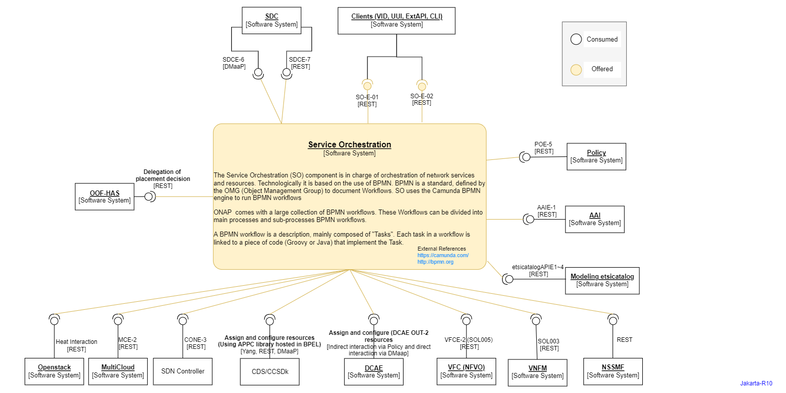

Slide 3
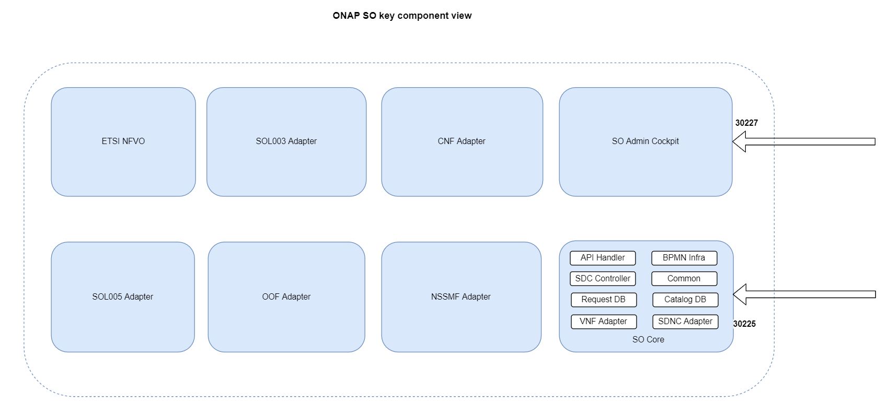

Slide 4
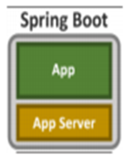
Deployment View
Spring Boot Application
BPMN Infra Jar
Request DB Adapter Jar
SDNC Adapter Jar
Cloud Adapter Jar
API Handler Jar
SDC Controller Jar
Catalog Adapter Jar
VFC Adapter Jar
VNFM Adapter Jar

Slide 5
Ext API
VID
UUI
CLI
DCAE
AAI
SDC
SO
OOF
Policy
VFC
MultiVim
APPC
SDNC

